Slide 1
Photosynthesis & Cellular Respiration

Slide 2
What is the equation for photosynthesis?
6CO₂ + 6H₂O ^{light energy}→ C₆H₁₂O₆ + 6O₂
carbon dioxide + water ^{light energy} → glucose + oxygen
What are the reactants of photosynthesis?
What are the products of photosynthesis?

Slide 3
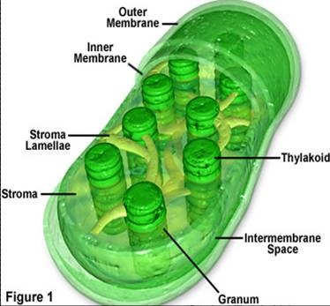
In which organelle does photosynthesis take place?
In the chloroplast!

Slide 4
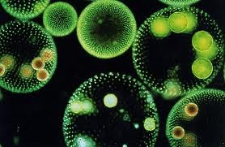
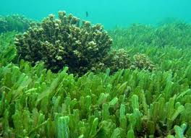
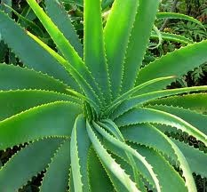
In which organism does photosynthesis take place?
Autotrophs!

Slide 5
What is Cellular Respiration?
The process that releases energy stored in foods.
It involves the breakdown of glucose molecules to release energy that cells need to function.

Slide 6
What is the chemical equation for cellular respiration?
What are the reactants of cellular respiration?
What are the products of cellular respiration?

Slide 7
During cellular respiration, cells break down food molecules to produce ATP. Cells use the energy in ATP to carry out processes.
Energy is released when a phosphate group is removed.
Energy is stored when a phosphate group is added.

