Slide 1
Food Chains, Food Webs, & Energy Pyramids
Thursday, September 17 (A)
Friday, September 18 (B)
Notes:
https://www.brainpop.com/science/ecologyandbehavior/foodchains/

Slide 2
Movie Time!
Brain Pop Video
Write down 3 new and/or interesting facts while you watch
Notes:
Write down 3 new/interesting facts as you watch
-after movie, have them share their fun facts with the class.
These notes go on opposite side of foldable

Slide 3
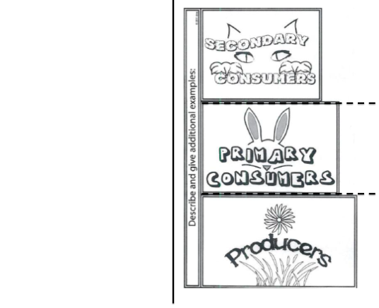
Food Chain Foldable Notes
Notes:
Pass out notes sheet. DO NOT glue this in yet.
Fold in half along solid line. Then glue the blank side down. Then cut along the dotted lines.

Slide 4
Producers are able to make their own food using photosynthesis.

Slide 5
Producers:
largest part of any food web
found at the bottom of all food chains
Notes:
This information + what’s on the next slide will go under the producers flap. Write small or write one slide’s info on the left and the other on the right.

Slide 6
Primary consumers eat the producers.

Slide 7
Primary consumers are also called herbivores.

Slide 8
Secondary consumers eat the primary consumers.

Slide 9
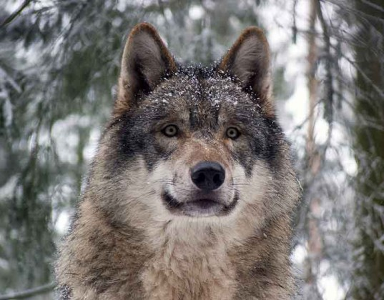
They are also known as carnivores, or meat-eaters

Slide 10
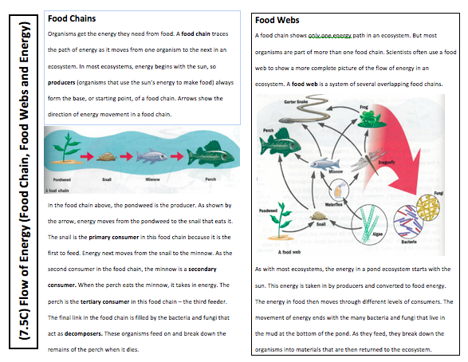
Flow of Energy Reading & Questions
Notes:
Glue this page in then answers the questions on the separate sheet.
Independent work.

